Slide 1
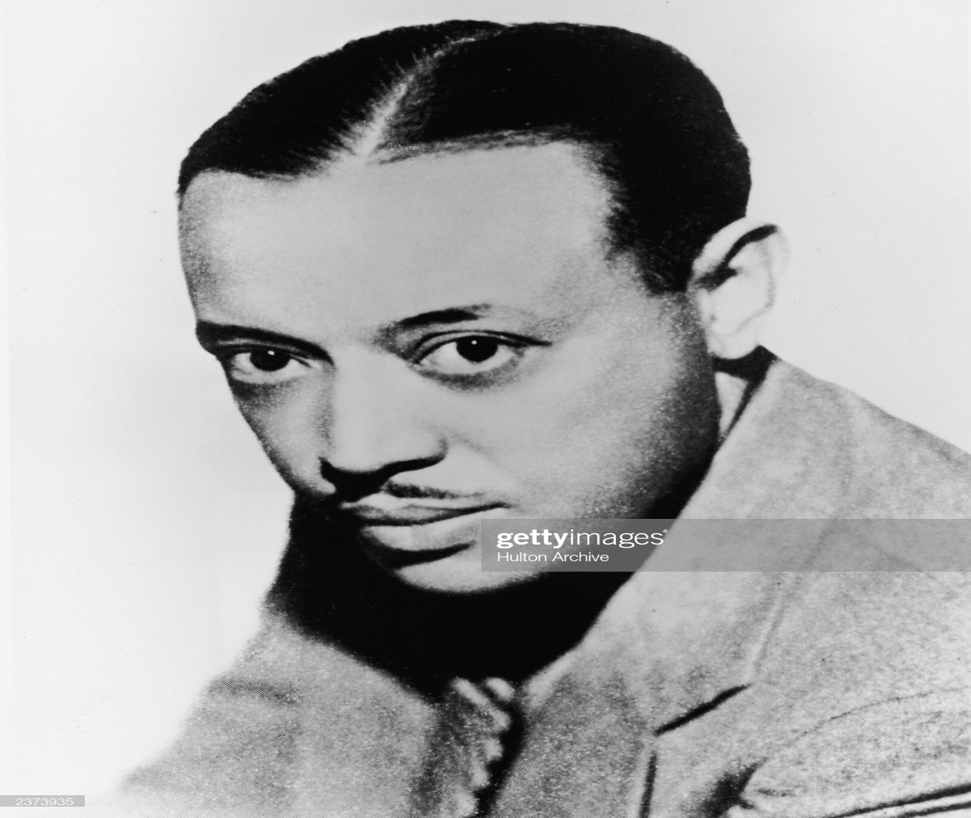
WILLIAM GRANT STILL

Slide 2
Introduction
Born on may 11, 1895 in wood vile, Mississippi, US.
Died in December 3, 1978. Aged 83
His parents were Carrie Lena and William grant Sr.
He was a classical composer and orchestra
conductor
Notes:
William is one of the first American orchestral conductor and also a composer. During his early years in career he used to be a professional symphony orchestral in the united states . His outstanding work in Afro-American Symphony in 1931 not only made him famous but also motivated his other works such as composing ballets, operas and symphonies. Having been brought up by his mother and grandmother in Little rock , Arkanas he studied at Wilberforce University where he took a medicine course before turning into music. His diversity in musical education extended in 1920 while he was working as an arranger for the bandleader Paul Whiteman and for blues composer WC. Handy.

Slide 3
HIS FAMILY LIFE
While he was a baby, his father passed away.
His mother moved the family to live with Still’s grand mother
They lived in little Rock, Arkansas.
His childhood home was filled with the sounds of his grandmother singing
Notes:
William Grant’s mother when she moved to Little rock, Arkansas she taught English in high school for 33 years. Her mother married Charles B. Shepperson who later had great impact on his stepson William's musical interest by taking him to record classical musical and also buy red seals in Operettas. The two used to attend to music concerts and tours . His maternal grandmother sang African-American spirituals to him. At the age of 15 William started attending violin lessons in little Rock. He taught himself how to play saxophone, double bass, cello and viola. At the age of 16 he graduated from M.W Gibbs High school in little Rock.

Slide 4
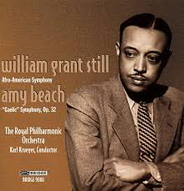
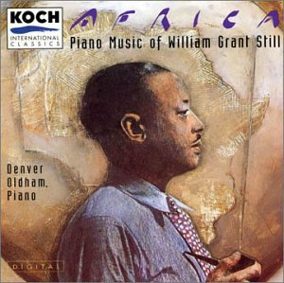
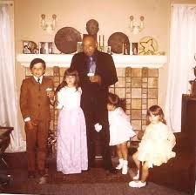
William grants pictures
Notes:
The picture above shows William still in his youthful years. The first picture on the left shows an advertisement picture which was set to inform people on his performance venue during those days. The picture at the Centre shows grants graphics which possibly was a piece of art by one of his funs to him. The picture on the right hand shows William Grants together with friends of his two children cerebrating a birthday of the younger children.

Slide 5
Some of WILLIUM GRANTS STILL SONGS
TROUBLED ISLAND
INCANATION AND DANCE
A BOYOU LEGEND
SAHDJI
Notes:
William still joined the united states Navy to serve the world war 1 and he also worked as an arranger for W.C Hand's . In 1921 he recorded his first dance orchestral with Fletcher Henderson. Later in 1920s he served as the arranger of yamekraw. In 1955 he conducted the new Orleans philharmonic Orchestral and he was the first African American to conduct such a major orchestra in the deep south.

Slide 6
LEGACY AND HONOURS
Guggenheim fellowship
Honorary doctorate from Oberlin college, Wilberforce university, onward University, Bates college
The 1992 Mississippi arts and letters

